Slide 1
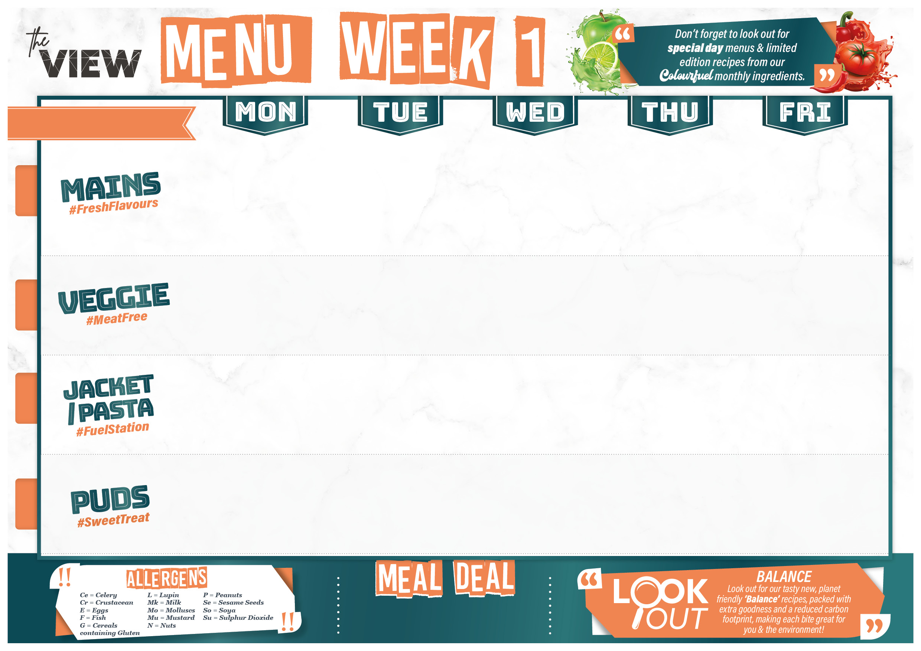
We 2nd sept 23rd sept Oct 14th Nov 4th Nov 25th Nov 16th Dec
- BALANCE - Kung Pao chicken with rice or Singapore noodles (G,SO,MU,E,CE) | Chicken Sausage, onion gravy, creamy mash and garden peas (G,SU,MK) | - BALANCE - Classic Beef burger with sliced tomato, BBQ sauce, lettuce and red onions, Cajun Potatoes (G,SE,MK,E,Mu) | Mexican turkey with roasted peppers, beans chick peas, nacho and cheese topping (G,MU,MK) | Battered fish (G,SU,F,E) hot dog sausage in a bun with roasted onions and ketchup (G,SU,SE) Fish finger butty (G,SO,MK,F) All Served with chips and peas or beans
Kung Pao Chinese vegetables with rice or Singapore noodles (G,SO,MU,E,CE) | Veggie sausages, onion gravy, creamy mash and garden peas (SU,SO,MU,MK) | Baked veggie burger with cheese, tomato, lettuce and BBQ sauce, Cajun Potatoes (G,SE,MK,E,Mu) | Mexican Quorn with roasted peppers, beans and chick peas. nacho and cheese topping (G,MU,MK,E) | Cheese and tomato quiche (G,MK,E)
Cheese and beans filled jackets (MK) | Tuna sweetcorn mayonnaise filled jackets (F,E) | Cheesy coleslaw filled jackets (SU,MU,MK,E) | Chilli con carne filled jackets (MU) | Cheese and beans filled jackets (MK)
Chocolate sponge and chocolate sauce (G,MK,E) | Bread and butter pudding with custard (G,SU,SO,MK,E) | Jam and coconut sponge (G,MK,E) | Winter berry cheesecake (G,MK,E) | Apple crumble and custard (G,MK)
£2.16
£2.16
£2.16
£0.96
Main Meal + Water or Dessert
FOR ONLY £2.73

Slide 2

We 9th sept, 30th sept 21st Oct
11th Nov 2nd Dec 23rd Dec
- BALANCE - Chicken Balti with pilau rice and chutney | - BALANCE - Cottage Pie Served with whole Green Beans (Mk) | Roast Chicken with roasties, stuffing and roast gravy. Carrots and broccoli (G) (G,SO) | - BALANCE - Baked lasagne topped with mozzarella with salad (G,SU,SO,MK,E,CE) Extra garlic bread (G,SO,MK) | Battered fish (G,SU,F,E) Baked jumbo sausage roll (G,SU,SO,MK) All Served with chips and peas or beans
Sweet potato and cauliflower curry with pilau rice (MU,MK) | Veggie Cottage Pie served with Whole Green Beans (E,Mk) | Veggie quesadilla with potato wedges and coleslaw (G,SU,MU,MK,E) | Roasted vegetable lasagne topped with mozzarella with salad (G,SO,MK) Extra garlic bread (G,SO,MK) | Baked Mac and Cheese with crusty topping (G,SO,MK)
Cheese and beans filled jackets (MK) | Tuna sweetcorn mayo filled jackets (F,E) | Cheesy coleslaw filled jackets (SU,MU,MK,E) | Chilli con carne filled jackets (MU) | Cheese and beans filled jackets (MK)
Greek lemon sponge with custard (G,MK,E) | Carrot cake (G,MK,E) | Dutch apple caramel tart with custard (G,SO,MK,E) | Pear and apricot crumble with custard (G,MK) | Rice pudding with raspberry sauce (MK)
£2.16
£2.16
£2.16
£0.96
Main Meal + Water or Dessert
FOR ONLY £2.73

Slide 3

We 16th sept 7th Oct, 28th Oct
18th Nov 9th Dec
- BALANCE - Chilli con carne with tomato, garlic and spring onion rice (SO,G) | - BALANCE - Thai green chicken curry with steamed rice | - BALANCE - Beef bolognaise pasta bake with chefs’ salad (G,SU,SO,MK,CE) | Sausage and baked bean casserole with chipotle BBQ sauce and mashed potato (SU,MK,G) | Battered fish (G,SU,F,E) Hot dog sausage in a bun with roasted onions and ketchup (G,SU,SE) Fish finger butty (G,SO,MK,F) All Served with chips and peas or beans
Vegan Chilli with tomato, garlic and spring onion rice (SO,MU,CE) | Thai green vegetable curry with steamed rice | Veggie mince pastitsio with chef’s salad (G,SU,SO,MK,CE) | Oven baked gnocchi with tomato, mozzarella and pesto served with garlic bread (G,SO,MK,E) | Cheddar cheese, leek and potato filo pie (G,MK,E) Chip butty and curry sauce
Cheese and beans filled jackets (MK) | Tuna sweetcorn mayonnaise filled jackets (F,E) | filled jackets (SU,MU,MK,E) | Chilli con carne filled jackets (MU) | Cheese and beans filled jackets (MK)
Jamaican ginger cake with custard (G,MK,E) | Banoffee pie (G,SO,MK) | Sticky toffee pudding with toffee sauce (G,Su,Mk,E) | Lemon blondie (G,E) | Apple and rhubarb crumble with custard (G,MK)
£2.16
£2.16
£2.16
£0.96
Main Meal + Water or Dessert
FOR ONLY £2.73

